Slide 1
Digital Image Processing Technologies & Applications
Color Image Processing

Slide 2

Contents
Color fundamentals
Color models
Pseudo color
Intensity slicing
Gray level to color transform
Multispectral color models

Slide 3
Color Fundamental
Motivation
Color is a powerful descriptor that often simplifies object identification and extraction from a scene.
Humans can discern thousands of color shades and intensities.
Only two dozen or so shades of gray.
Full Color
The images are acquired with a full color sensor, such as color TV camera, color scanner.
Pseudo Color
Assigning colors to monochrome images.
Based on specified criterion.

Slide 4
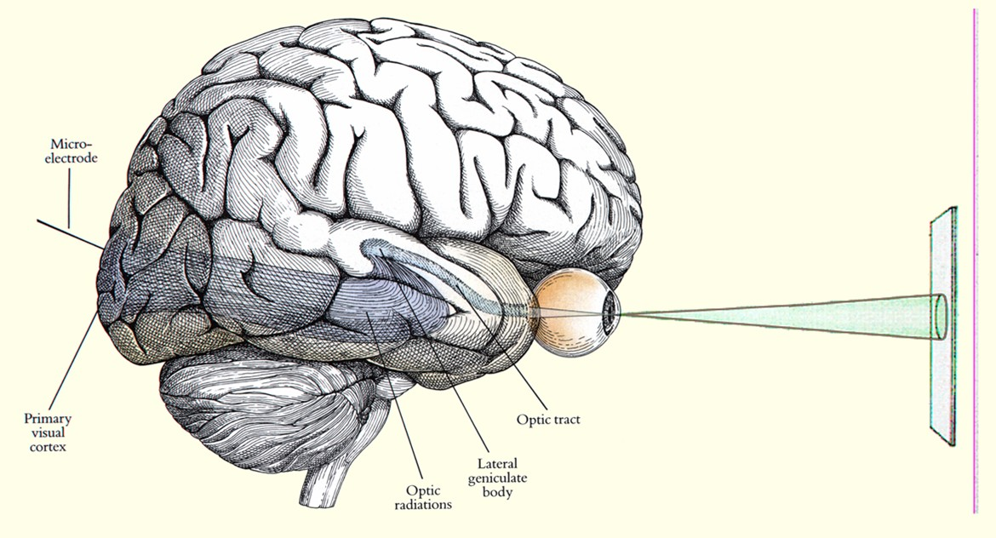
Color Fundamental
The process followed by the human brain in perceiving and interpreting color is a physiological-psychological phenomenon
It is not yet fully understood.
The physical nature of color can be expressed on a formal basis supported by experimental and theoretical results.

Slide 5
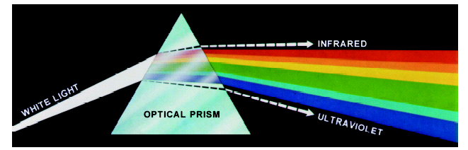

Color Fundamental
1666, Newton.
Ultra-
Short-
AC
Gamma
X rays
violet
Infrared
Radar
FM
TV
wave
AM
electricity
10
-12
10
-8
10
-4
1
10
4
10
8
Wavelength in meters (m)
Visible light
400 nm
500 nm
600 nm
700 nm
Wavelength in nanometers (nm)

Slide 6
Color Fundamental
Light and Spectra
Visible light is an electromagnetic wave in the 400 nm-700 nm range.
Most light we see is not one wavelength, it's a combination of many wavelengths.
The colours that we perceive are determined by the nature of the light reflected from an object
An object that reflects light that is balance in all visible wavelengths appears white to the observer.
White Light
Colours Absorbed
Green Light

Slide 7
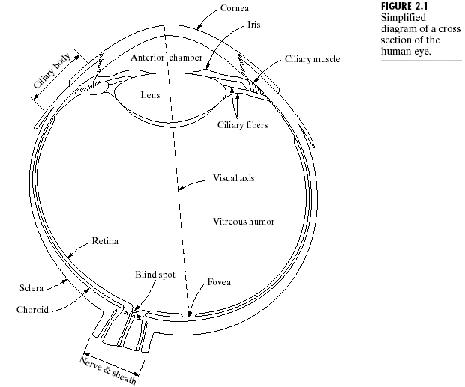
Color Fundamental
Human retinas have two types of photoreceptors
Cones
As noted in Section 2.1.1, cones are the sensors in the eye responsible for color vision
High light level, high acuity vision
Each type of cone has a different spectral response
Rods
Rods are more spread out and are sensitive to low levels of illumination

Slide 8
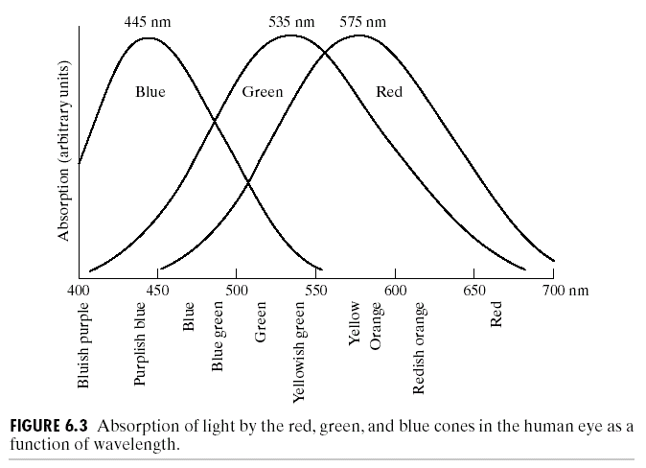
Color Fundamental
Detail experimental evidence has established that the 6 to 7 million cones in the human eye can be divided into three categories, corresponding roughly to RED, GREEN, and BLUE (1965).
65% --sensitive to red light
33% --sensitive to green light
2% --sensitive to blue light (but the blue cones are the most sensitive)

Slide 9
Color Fundamental
Due to these absorption characteristics of the human eyes, colors are seen as variable combinations of the so called primary colors: RED (R), GREEN (G), and BLUE (B).
For purpose of standardization, the CIE(Commision Internationale de I’Eclairage – the International Commission on Illumination) designated in 1931 the following specific wavelength values to the three primary colors:
Red: 700 nm
Green: 546.1 nm
Blue: 435.8 nm

Slide 10
Color Fundamental
Note:
No single color may be called Red, Green, or Blue.
It is not mean that these three fixed RGB components can generate all spectrum colors
Use the word primary has been widely misinterpreted to mean that the three standard primaries, when mixed in various intensity proportions, can produce all visible colors.

Slide 11
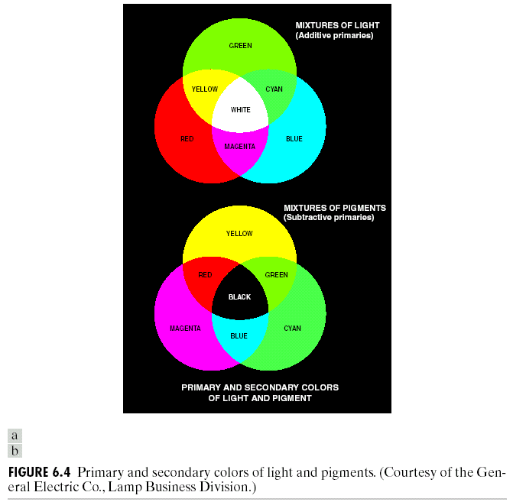
Color Fundamental
The primary colors can be added to produce the secondary colors of light:
Magenta (深红色) = Red + Blue
Cyan (青色) = Green + Blue
Yellow (黄色) = Red + Green
Mixing the three primaries, or a secondary with its opposite primary color, in the right intensities produces white light.

Slide 12
Color Fundamental
Note: The difference of the primary colors of light and the primary colors of pigments or colorants.
Primary colors of pigments:
Magenta (深红色) - Red + Blue;
Cyan (青色) - Green + Blue;
Yellow (黄色)- Red + Green.

Slide 13
Color Fundamental
The characteristics used to distinguish one color from another are:
Hue
Hue represents dominant color as perceived by an observer.
An attribute associated with the dominant wavelength in a mixture of light waves.
Thus, when we call an object red or yellow, we are specifying its hue.
Saturation
The pure spectrum colors are fully saturated, colors such as pink (red and white) are less saturated.
Saturation being inversely proportional to the amount of white light added.
Brightness (Intensity)
Embody the chromatic notion of intensity

Slide 14
Color Fundamental
Hue and saturation taken together are called Chromaticity (彩色).
Therefore, a color may be characterized by its brightness and chromaticity.
The amounts of red, green, and blue needed to form any particular color are called the tristimulus (三色值或三刺激值) values and are denoted X, Y, and Z, respectively.

Slide 15
Color Fundamental
A color is then specified by its trichromatic coefficients:

Slide 16
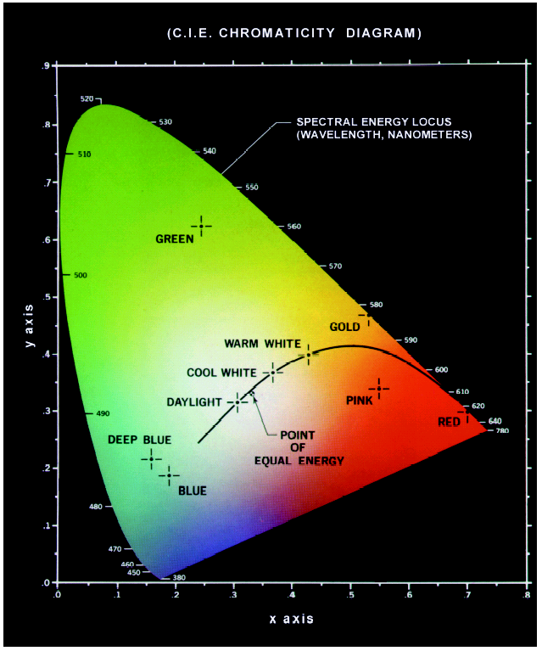
Color Fundamental
Another way for specifying colors is to use the CIE Chromaticity diagram.
X axis: Red
Y axis: Green
Point GREEN:
x=25%, y=62%, then z=13%
Saturation=0
Saturation=66%

Slide 17
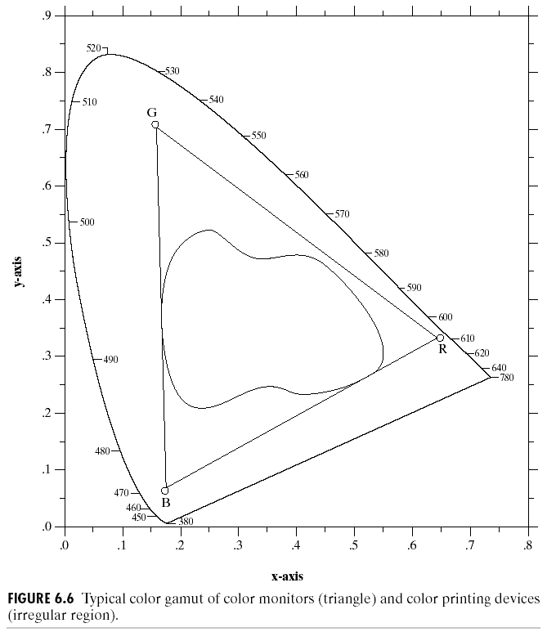
Color Fundamental
Typical range of colors produced by RGB monitors.
The color represented by high quality color printing devices.

Slide 18
Color Models
Color model is also called color space, color system.
The purpose of color model is to facilitate the specification of colors in some standard.
Two types of color model:
Hardware oriented: such as printer, monitor
Application oriented: such as animation, medical image processing
Typical color models:
RGB model
CMY or CMYK model
HSI Model
YIQ and YUV models
Many other color models, Lab, HSV, HSB, …

Slide 19
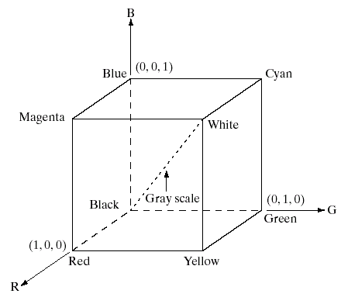
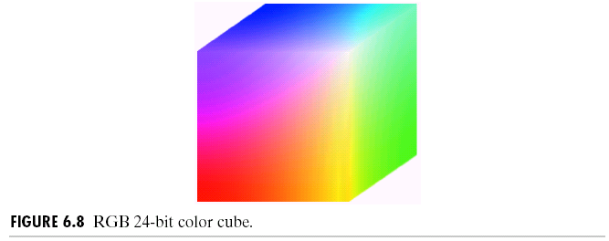
Color Models
Assumption is that all color values are normalized to the range of [0, 1].

Slide 20
RGB Image
Images represented in RGB color model consist of three component images, one for each primary color.
When fed into RGB monitor, these three images combine to produce a composite color image
Pixel depth: the number of bits used to represent each pixel in RGB space.
Consider each R, G and B components with 8-bits pixel depth. We called the color image is full color with 24 bits, which can represent 16772216 ( ) number of colors.
How about 32 bits full color?
24 bits full color+8 bits Opacity(Alpha)
=> RGBA
111
14
126
36
12
36
36
111
36
12
17
111
200
36
12
36
14
36
36
17
111
200
36
12
200
111
14
126
17
111
14
36
12
36
14
36
10
128
126
200
12
111
36
36
17
111
36
14
36
111
14
126
17
111
17
36
36
14
36
72
17
126
12
72
126
17
111
12
36
126
200
36
12
17
126
17
111
200
200
36
12
36
12
126
14
200
36
12
126
17
72
12
17
111
14
36
126
200
111
14
36
72
36
12
17
72
106
155
10
200
128
126
200
12
111
111
14
36
126
12
36
36
12
14
36
36
17
200
36
111
36
14
14
126
36
17
72
111
36
111
36
12
17
111
12
36
17
36
126
111
17
36
111
14
200
36
17
111
200
36
12
36
14
17
200
126
36
72
12
126
126
17
17
111
14
36
12
36
14
36
126
200
200
36
111
12
14
36
36
12
72
126
17
111
14
126
17
111
36
72
12
12
17
17
72
111
106
14
155
36
12
126
200
36
12
36
Notes:
但32位色就并非是2的32次方的色数，它其实也是16777216色，不过它增加了256阶颜色的灰度也就是8位透明度，色数其实2的24次方，但是增加了8位透明度，就规定它为32位色。

Slide 21
RGB Image

Slide 22
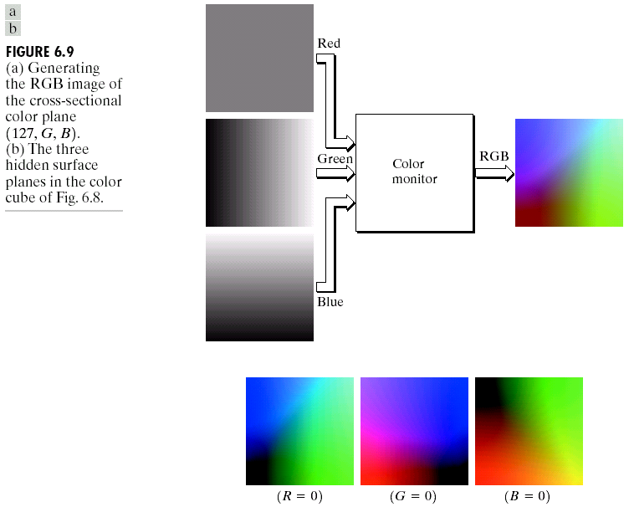
Color Models
B
Plane with R=127
R
G

Slide 23
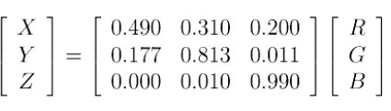
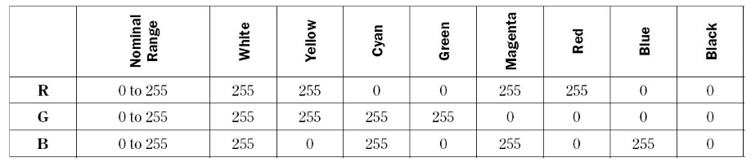
Color Models
CIE XYZ system

Slide 24
Color Models
CMY and CMYK color models——For printer
Cyan (青), magenta (品红), and yellow (黄) are the secondary colors of light. Or the primary colors of pigments.
Assumpting all color values have been normalized to the range [0, 1].
For example, when a surface coated with cyan pigment is illuminated with white light, no red light is reflected from the surface. That is cyan subtracts red light from reflected white light. (C=1-R)

Slide 25
Color Models
CMYK color models
K is true black.
Equal amounts of pigment primaries should produce black.
In practice, combining these colors for printing produces a muddy looking black.
So a fourth color k is added to produce true black.
So called four-color printer.

Slide 26
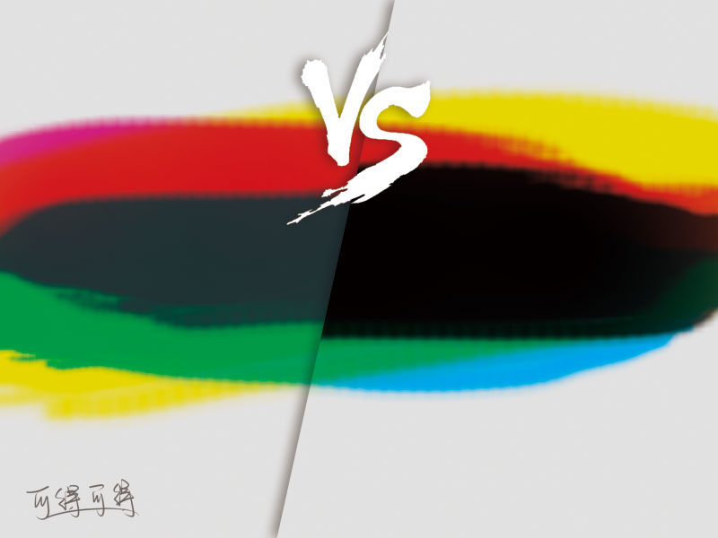
Color Models
Notes:
1、由于油墨的制造水平，CMY三色叠加后，不可能达到纯黑的效果；
2、三色油墨叠加后，才得到一个最常用的黑色，太浪费油墨；
3、三色分别叠加印刷，印刷机会有套印误差，影响美观；
4、多色油墨叠加后，油墨在纸张上太厚，不易干燥，易粘脏印刷品；
5、黑色不纯，风景、人物等图像印刷时明暗对比效果差；

Slide 27
Color Models
As we see, changing from RGB to CMY color model is very easy. And these systems are ideally suited for hardware implementations.
However, RGB and CMY are not well suited for describing colors for human interpretation.
Hard to understand color images are being composed of three primary images.
When humans view a color object, we describe it by its hue, saturation, and brightness.
HSI model.

Slide 28
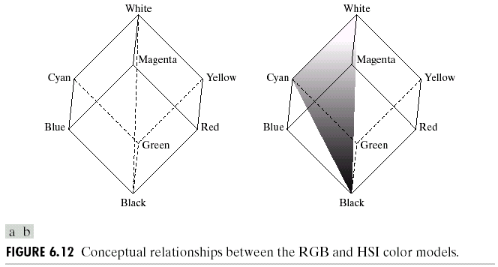
Color Models
Intensity axis Saturation is zero along the
intensity axis
Hue is the same in the plane

Slide 29
Color Models
HSI can be obtained from the RGB color cube
HSI space
A vertical intensity axis.
The locus of color points that lie on planes perpendicular to this axis.
The boundaries is either a triangular or hexagonal shape.

Slide 30
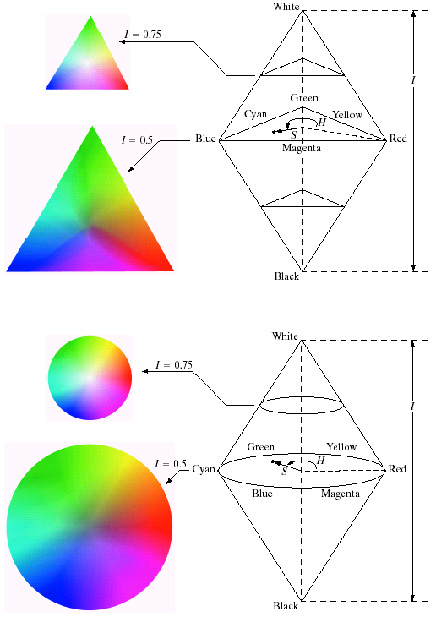
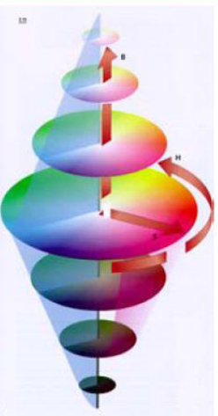
Color Models

Slide 31
Color Models
The shape of color space has not effect to HSI model.
White
I
S
Black
Thinking:
Point remove up or down
Rotation in clockwise or counter-clockwise
Red point moves to the center

Slide 32
Color Models
S
Point remove up or down

Slide 33
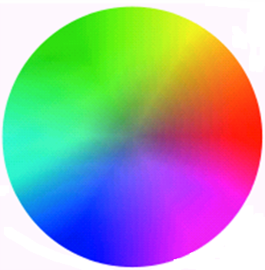
Color Models
S
Rotation in counter-clockwise

Slide 34
Color Models
S
Red point moves to the center

Slide 35
Color Models
Converting colors from RGB to HSI (R,G,B are normalized)

Slide 36
Color Models
Converting colors from HSI to RGB

Slide 37
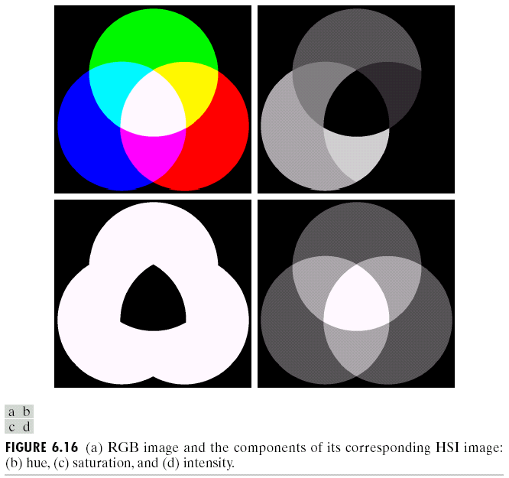
Color Models
Value of hue corresponds to angles with RED. Then Red area is 0 in Hue component.
The saturation of primary Red, Green, Blue are 1.
Then these three areas are white.

Slide 38
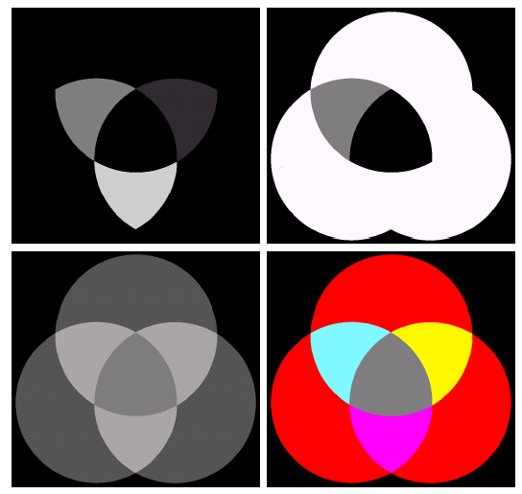
Color Models
Obtained by changing the pixels corresponding to blue and green regions to 0.
Reduced by half the saturation of the cyan region in component image S.
Reduced by half the intensity of the central white region in the intensity image.

Slide 39
YIQ and YUV Color Model
YIQ is the color model used for color TV in America (NTSC) .
Y is luminance, I & Q are color (I=red/green, Q=blue/yellow).
YUV is the color model used for color TV in China (PAL), and in video.
Y is luminance, U and V are blue and red as in YIQ.
Notes:
电视制式有中国、欧洲使用的PAL制，美国、日本使用的NTSC制及法国等国所使用的SECAM制.
电视系统中用YUV和YIQ模型来表示的彩色图像。 ·PAL彩色电视制式中使用YUV模型：Y表示亮度信号，U、V表示色差信号，UV构成彩色的两个分量。 ·NTSC彩色电视制式中使用YIQ模型，其中Y表示亮度，I、Q是两个彩色分量。
YUV 彩色空间特点 · 亮度信号（Y）和色度信号（U，V）是相互独立的，也就是Y信号分量构成的黑白灰度图与用U，V信号构成的另外两幅单色图是相互独立的。由于Y，U，V是独立的，所以可以对这些单色图分别进行编码。黑白电视机能够接收彩色电视信号也就是利用了YUV分量之间的独立性。
电视系统为什么采用YUV或YIQ模型呢？
·眼对彩色图象细节的分辨本领比对黑白图象低，因此，对色差信号， U , V，可以采用“大面积着色原理”。 大面积着色原理
· 用亮度信号Y 传送细节，用色差信号U . V 进行大面积涂色。因此，彩色信号的清晰度由亮度信号的带宽保证，而把色差信号的带宽变窄。正是由于这个原因，在多媒体计算机中，采用了YUV彩色空间，数字化的表示，通常采用Y:U:V = 8:4:4， 或者 Y:U:V = 8:2:2。 ·例如8:2:2具体的做法是：对亮度信号Y，每个像素都用8位2进制数表示（可以有256级亮度），而U ， V 色差信号每4个像素点用一个8位数表示，即画面的粒子变粗，但这样能够节约存储空间，将一个像素用24位表示压缩为用12位表示，节约1/2存储空间，而人的眼睛基本上感觉不出这种细节的损失，这实际上也是图像压缩技术的一种方法。

Slide 40
Problem in Color Image
When processing colour images, the following problems have to be dealt with:
The images are vectorial → 3 or 4 numbers are associated with each pixel.
The colours recorded by a camera are heavily dependent on the lighting conditions.

Slide 41
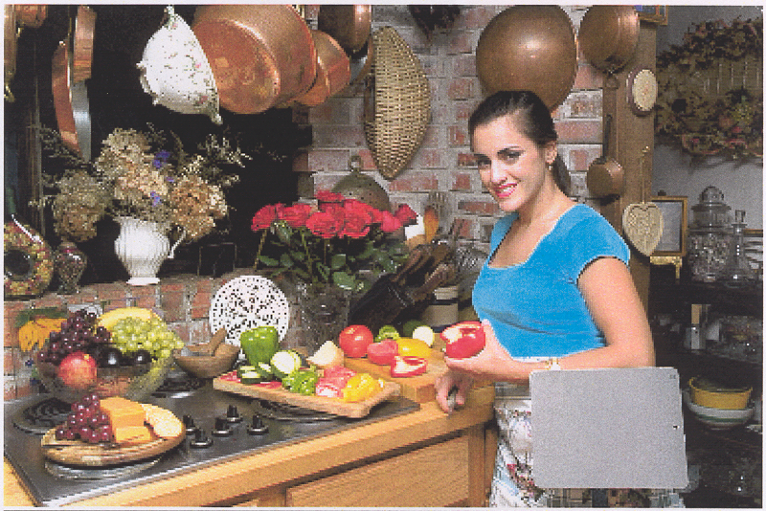
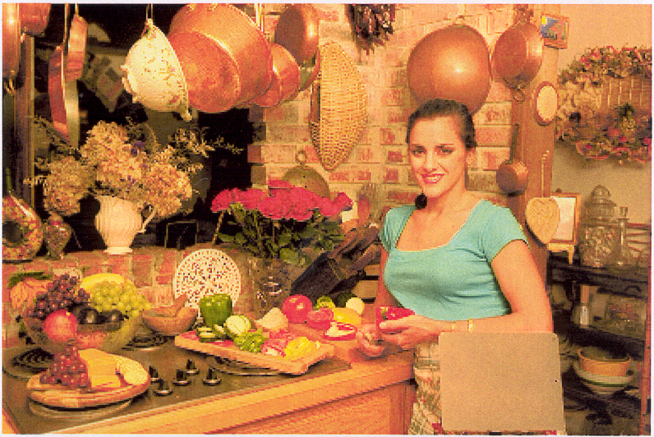
Problem in Color Image
The lighting conditions of the scene have a large effect on the colours recorded.
Image taken lit by a flash.
Image taken lit by a tungsten lamp.
Notes:
tungsten
n. [化学] 钨（一种金属元素）

Slide 42
Problem in Color Image
Knowing just the RGB values is not enough to know everything about the image.
The R, G and B primaries used by different devices are usually different.
For scientific work, the camera and lighting should be calibrated.

Slide 43
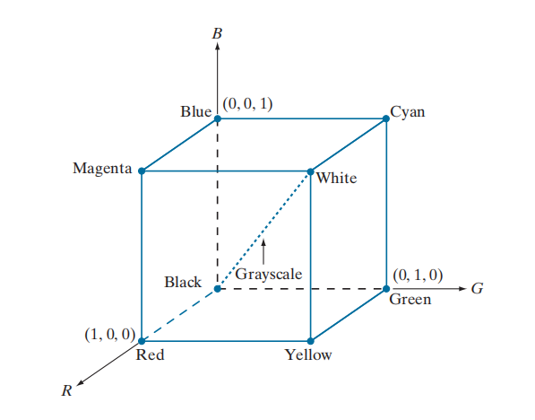
Pseudo Color Processing
The principle of pseudo color is for human visualization and interpretation of gray scale events in an image.
Pseudo color processing
Intensity slicing
Gray level to color transform
Multispectral color models

Slide 44
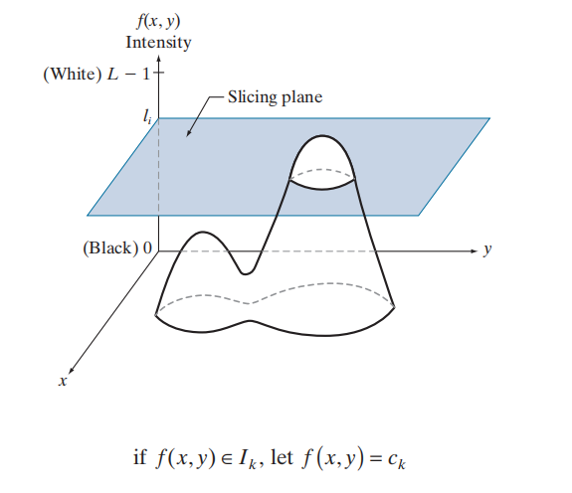
Intensity Slicing
Any pixel whose gray level is above the plane will be coded with one color, and pixel below the plane will be coded with another color.

Slide 45
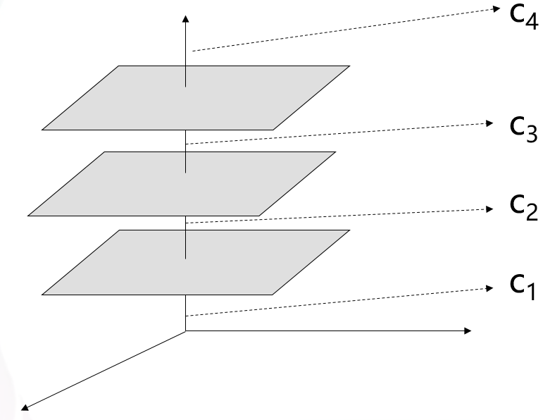
Intensity Slicing
Let represent the gray scale, let level represent black
Let level represent white
Suppose that P planes perpendicular to the intensity axis are defined at level
Assuming that , the P planes partition the gray scale into P +1 intervals
Intensity Slicing
color coding

Slide 46
Intensity Slicing

Slide 47
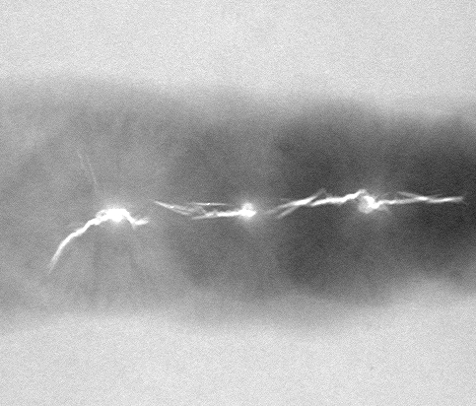
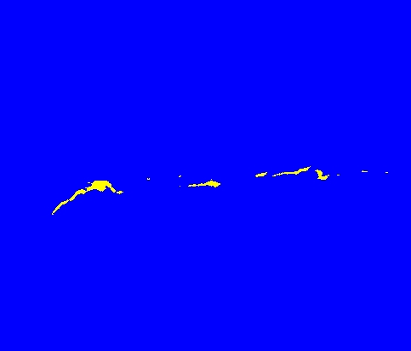
Intensity Slicing

Slide 48
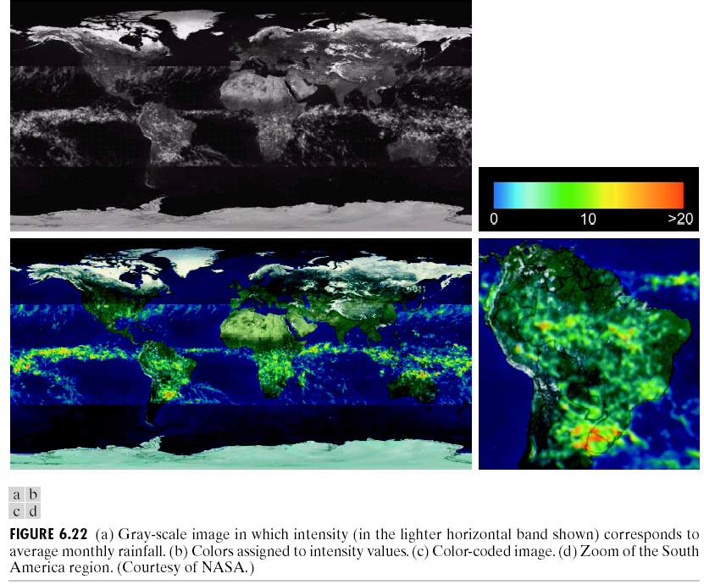
Intensity Slicing

Slide 49
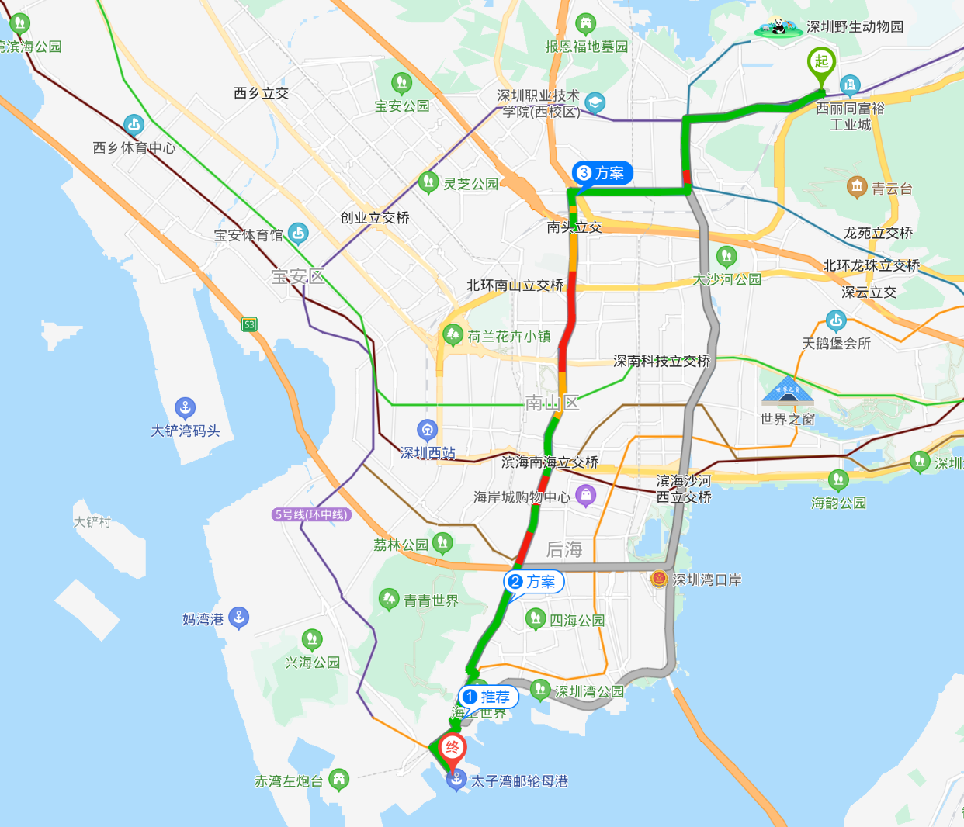
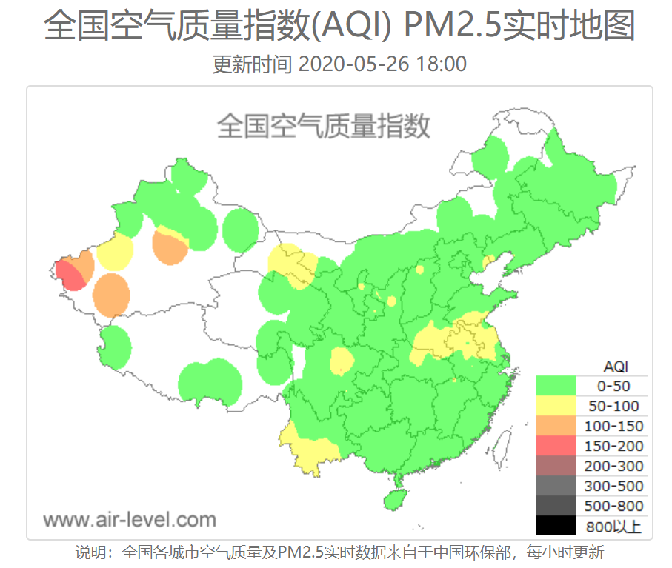
Intensity Slicing

Slide 50
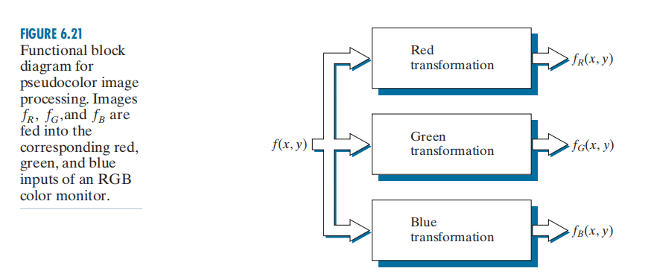
Gray Level to Color Transformation
Note: These are transformations on the gray level values of an image and not functions of position.

Slide 51
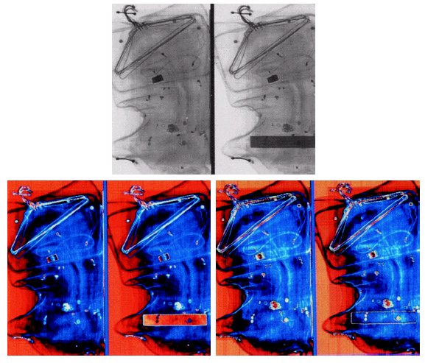
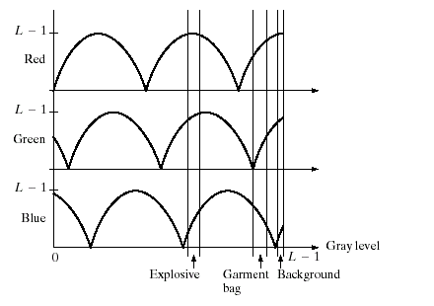
Gray Level to Color Transformation
Notes:
explosive
adj. 易爆的，可能引起爆炸的

Slide 52
Gray Level to Color Transformation
Notes:
explosive
adj. 易爆的，可能引起爆炸的

Slide 53
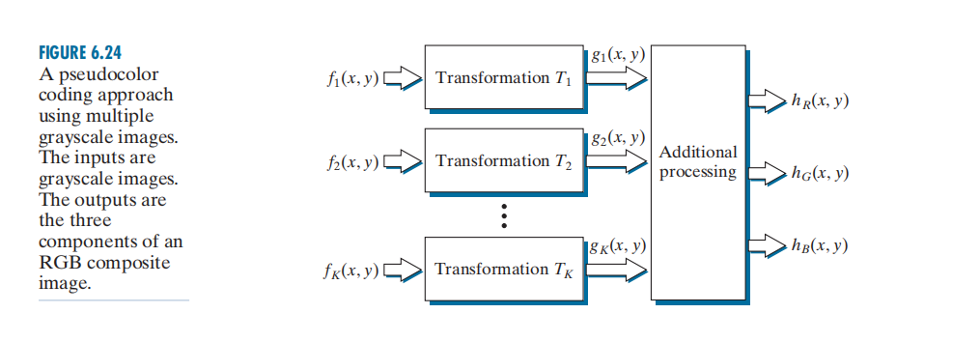
Gray Level to Color Transformation

Slide 54
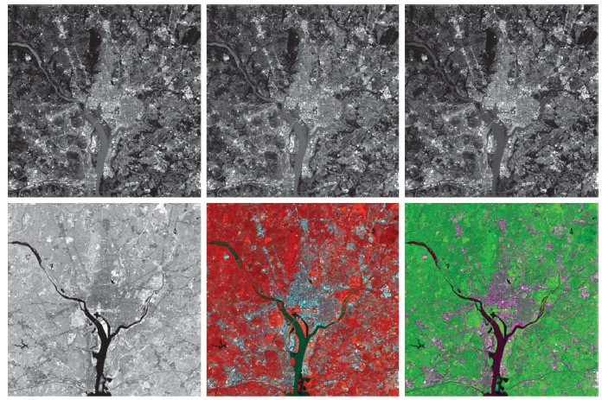
Gray Level to Color Transformation
Notes:
(a)–(d) Red (R), green (G), blue (B), and near-infrared (IR) components of a LANDSAT multispectral image of the Washington, D.C.
area. (e) RGB color composite image obtained using the IR, G, and B component images. (f) RGB color composite image obtained
using the R, IR, and B component images.

Slide 55
Summary
In this lecture we have learned:
Color Fundaments
Color Model
Pseudo-color processing
Next we will look at:
Full-color transformation
Smoothing and Sharpening
Color Slicing
Noise in color images

